Slide 1


UNIVERSITY OF PUERTO RICO - MAYAGUEZ
COLLEGE OF ARTS & SCIENCES
ECONOMICS DEPARTMENT
CENTER FOR ECONOMIC AND FINANCIAL EDUCATION
Civis Module:
Income & Decisions
Jeffry Valentin Mari, Ph.D
Associated Professor

Slide 2

If we teach pre-university students to read, write, add, subtract, …
Why many of our young people, once complete their higher education, are totally left behind in the global economy?

Slide 3
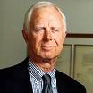
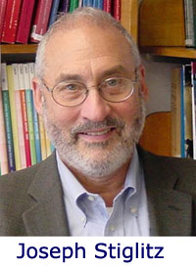
“The American economy is the eighth wonder of the world; the ninth is the economic ignorance of the American people.”
  - Arthur Levitt, Chairman SEC (1993-2001)
“The public has chosen to speak and vote on economic problems, so the only open question is how intelligently it speaks and votes.”
  - George Stigler, University of Chicago economist and 2001 Nobel laureate

Slide 4

Three Fundamental Lifetime Decisions
Acquisition of a property to generate an heritage.
Planning for your retirement.
The choice of a career.

Slide 5
The Impact of the Information and Technology Revolution
Accessibility
  More than twenty years ago, banking services were operated using passbooks and offered only at branches. Today, banks are effectively open 24-hours a day, seven-days-a-week and customers need not even leave home or place of business to do their banking.
Complexity
  Consumers face an increasingly complex array of new financial services and products about which they must make wise choices.

Slide 6

Think Twice before taking the Big Step toward Student Loans

Slide 7
College Students Average Debt Levels for the Class of 2008
High Debt States
Low Debt States
State | Average Debt
DC | $29,793
Iowa | $28,174
Connecticut | $26,138
New York | $25,950
New Hampshire | $25,785
Minnesota | $25,558
Pennsylvania | $25,219
Vermont | $25,047
Rhode Island | $24,973
Maine | $24,916
State | Average Debt
Utah | $13,041
Hawaii | $15,156
Kentucky | $15,951
Wyoming | $16,307
Arizona | $17,059
Georgia | $17,296
California | $17,759
Louisiana | $17,827
Nevada | $17,921
Colorado | $18,321
Source: Student Debt and the Class of 2008. The Project on Student Debt. December 2009

Slide 8
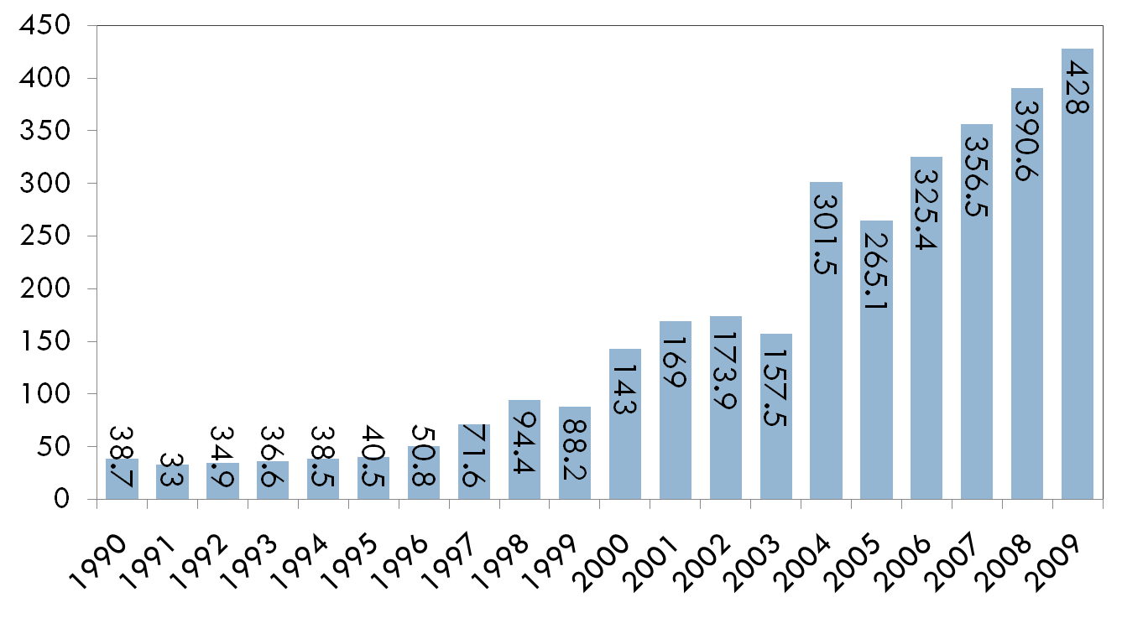
Puerto Rico’s Student Loans: Fiscal Years1990-2009
(in millions of $)
Source: Puerto Rico Planning Board. Economic Report to the Governor.

Slide 9
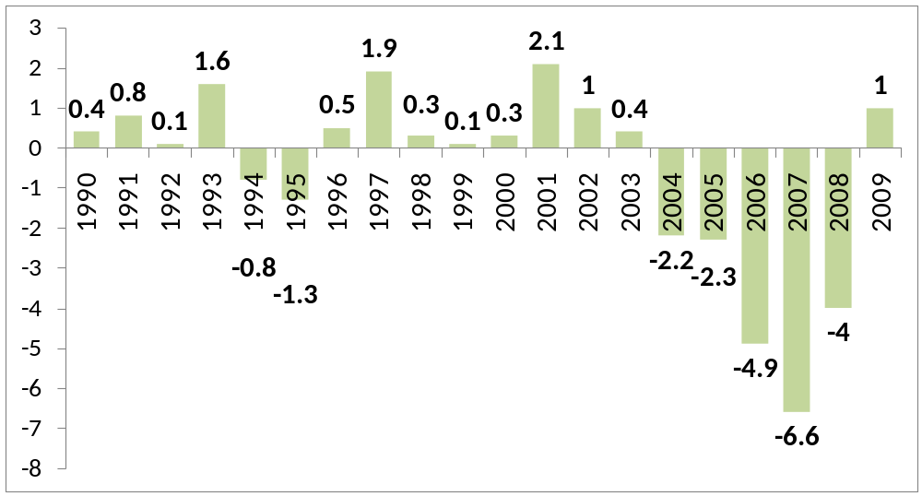
Puerto Rico’s Personal Saving Rate: Fiscal Years, 1990-2009
percent
Source: Puerto Rico Planning Board. Economic Report to the Governor. Several Years.

Slide 10
Key question…
Are we offering our students the tools to be successful in real life?

Slide 11
Think about it…
The skill-set today’s students will need to possess in order to succeed as professionals is likely to be markedly different than that of a generation ago.
This skill-set must empower students with an economic and entrepreneurial way of thinking, to be prepared for the myriad opportunities – and threats – they will encounter as professionals.
The degree to which they succeed in this endeavor will shape not only their futures and their fortunes, but the level of competitiveness and dynamism of our economy.

Slide 12
Objectives
Explain how limited personal financial resources affect the choices people make.
Identify what they gain and what they give up when they make choices.
Make effective decisions as consumers, producers, savers, investors, and citizens.
Understand what determines the real buying power of money to make better decisions as active citizens in the economy.
Design a budget plan.

Slide 13

ECON Educational Standards
Standard 1: Productive resources are limited. Therefore, people cannot have all the goods and services they want; as a result, they must choose some things and give up others.
Standard 2: Effective decision making requires comparing the additional costs of alternatives with the additional benefits. Most choices involve doing a little more or a little less of something; few choices are all-or-nothing decisions.
Standard 11: Money makes it easier to trade, borrow, save, invest, and compare the value of goods and services.

Slide 14

FINA Educational Standards
Financial Responsibility and Decision Making: People make choices because they have limited financial resources and cannot have everything they want. A first step toward reaching financial goals is to identify needs and wants and rank them in order of importance. A decision-making process can help people make money decisions. Financial choices that people make have benefits, costs, and future consequences.

Slide 15
FINA Educational Standards
Planning and Money Management: A budget is a plan for spending and saving income. A budget identifies expected income and expenses, including saving, and serves as a guide to help people live within their income. A personal financial plan should include the following components: financial goals, a net worth statement, and income and expense record, an insurance plan, a saving and investing plan, and a budget.

Slide 16


MATH Educational Standards
Number and Operations Standard
  Understand numbers, ways of representing numbers, relationships among numbers, and number systems.
Measurement Standard
  Understand measurable attributes of objects and the units, systems, and processes of measurement
http://standards.nctm.org/

Slide 17
Visual 1- Functions & Property of Money
What’s the purpose of money? Imagine that for one day, money didn’t exist. What would be the impact on daily life?
Does the value of money stay constant? What are some factors that might affect the value of the dollar?
Has anyone here opened a savings account at a bank? What are the reasons you decided to do so?
Name an item that might increase (or decrease) in value the longer that you own it. Why would it be worth more (or less) over time?

Slide 18
Review - Visual 1
Money is a way to store, measure, and exchange value.
In the U.S., money is printed by the Department of the Treasury of the federal government.
Whenever one person or group spends money, another person or group gains money. Money is constantly moving through our economy in a never-ending cycle.

Slide 19
Review - Visual 1
If you deposit money at a financial institution, like a bank, they’ll often reward you by adding a small amount of extra money called interest on a regular schedule - the time value of money.
Inflation means an increase in the general price of goods and services, i.e., a decrease in the purchasing power of the dollar.

Slide 20
Review - Visual 1
Assets are anything of value owned by a person or company.
A liability is money an individual or business owes to someone else: a debt.
To build wealth, the value of what you own (your assets) needs to be more than the amount you owe to others (your liabilities).
If you want to build wealth, focus on buying assets likely to go up in value, or appreciate, over time.

Slide 21
Visual 2 - Benefits of Money Management
What are some future goals you have that are going to require saving money?
What are some things you never seem to have enough money for? How could creating a personal budget help you afford those things?
When you go shopping for a particular item, how do you decide whether the price is fair?
What are some things you could learn about someone by looking at his/her personal budget?
What can happen if you mismanage your money?

Slide 22
Activity 1- Goal Setting Worksheet
By Next Month | By Next Semester | By Graduation | Five Years After Graduation

Slide 23
Activity 1- Goal Setting Worksheet
By Next Month | By Next Semester | By Graduation | Five Years After Graduation
Buy a music CD | Get a part-time job | Buy a car | Buy a house or a apartment
Buy tennis shoes | Start saving $10 weekly | Buy a big HDTV | Open an IRA account
Buy a book | Buy a printer | Travel to Europe | Save an amount equal to three months of salary.

Slide 24
End of period one

Slide 25
Review
Most people can’t afford everything they want to buy, so they have to make tradeoffs.
One of the keys to good money management is to live within your means. This means living a lifestyle that you can afford. Don’t spend money faster than you earn it.
Avoid credit card debt. Whenever you use a credit card, you have to pay the money back!

Slide 26
Review
A personal budget is a written plan for reaching your financial goals.
To create your personal budget, first, write down your income, or how much money you have coming in during an average month. Next, write down your expenses, or the money you spend each month.

Slide 27
Review
There are two types of expenses: fixed and variable.
Fixed expenses are regular amounts that generally don’t change much. They can be monthly expenses like rent or car payments. Or they can be bills you receive less often, like car registration or insurance.
Variable expenses also happen on a regular basis and are also for necessities. But with variable expenses, you have more control over how much you spend.

Slide 28
Activity 2 – Student Budget Plan
INCOME | Amount ( $ )
Net Salary (part-time job)
Scholarships
Family Assistance (allowance, pension, gifts in money)
Educational Fund (IRA account)
Money debt
Saving Account
Others
Total Income

Slide 29
Activity 2 – Student Budget Plan
FIXED EXPENSES | Amount ( $ )
Apartment Rent
Tuition
Water
Electricity
Insurance (car, life, medical plan, others)
Cable TV, Internet
Organizations or associations, donations
Loans (monthly payments)
Credit cards (monthly payments)
Others
Total Fixed Expenses

Slide 30
Activity 2 – Student Budget Plan
VARIABLES EXPENSES | Amount ( $ )
Food
Clothing, shoes, accessories
School supplies (photocopies, paper, books, calculators, pencils, pens, notebooks, others)
Personal care (hair cut, beauty salon, cosmetics, others)
Transportation costs (gasoline, oil change, reparations)
Laundry (dry cleaners)
Health and dental services, others
Telephone (cellular)
Beverages and tobacco related products
Entertainment and recreation (theaters, movies, travels, sports, others social and cultural activities)
Others
Total Variable Expenses

Slide 31
Activity 2 – Student Budget Plan
Budget Items | Amount ( $ )
A. Total Income
Total Fixed Expenses + Total Variable Expenses
AVAILABLE CASH (A – B) (A – B) > 0 Savings (A – B) < 0 Debt

Slide 32
Recommendations
Create a budget you can live with. Be realistic. Review your budget every month. Adjust it as your income and expenses change.
After you have created a budget, plan your spending in order to make your monthly income last.
Consider your “needs” vs. your “wants.” Where can you save money?

Slide 33
Recommendations
Can you save by cutting back on eating out or buying the latest fad or fashion? Are you buying products or services you don’t really need?
Pay yourself!
Set aside any “extra” money you weren’t expecting to receive.
Pay your bills – including credit cards – in full and on time.

Slide 34
Visual 3 – Budget Guidelines
Housing (rent or mortgage) 20% to 35%
Utilities (electricity, water, telephone) 4% to 7%
Food (at home and away) 15% to 30%
Family necessities (laundry, toiletries, hair care) 2% to 4%
Medical (insurance, prescriptions, bills) 2% to 8%
Clothing 3% to 10%
Transportation (car payment, gasoline, insurance, repairs) 6% to 30%
Entertainment 2% to 6%
Savings 10% to 15%
Try to limit your installment debts (car loans, credit card bills, other loans) to 10-20% of your monthly budget.

Slide 35
Visual 4
To decide whether a purchase is necessary, ask yourself these questions:
  Do I really need it?
  Do I really need it today? What would happen if I don’t buy it now?
  Can I meet this need less expensively?

Slide 36
Activity 3 – Decision Making
Define the problem
  What to do this Friday night?
  What next after graduation day?
  How to spend the coming summer?
  Whether to buy a car?
Consider the alternatives for each problem

Slide 37
Activity 3 – Decision Making
Identify the criteria (goals/values) that are important to you. Example: (good grades, fun, relaxation).
Evaluate each alternative in terms of your criteria.
Make a decision by choosing the best alternative.

Slide 38
Assessment
___ 1. Inflation | Anything of value owned by a person, for example, cash, a house, a car, and stocks.
___ 2. Asset | An increase in the general price level of goods and services; a decrease in the purchasing power of the dollar.
___ 3. Liability | The amount of money an individual or business owes to someone else: a debt.
___ 4. Fixed expense | An expense that you can control or adjust, for example, how much you spend on groceries, clothes, or long distance phone calls.
___ 5. Variable expense | An expense that stays the same each month, such as rent or a car payment.

Slide 39
Assessment
1. An example of a short-term goal is:
a. Buying a new pair of shoes
b. Buying a car
c. Going to college
d. Going on a vacation to Europe
2. An example of a long-term goal is:
a. Working part-time
b. Buying a new video game
c. Graduating from college
d. Saving $25 a week

Slide 40
Assessment
3. An example of a fixed expense is:
a. Entertainment
b. Groceries
c. Clothes
d. Rent
4. An example of a flexible expense is:
a. Health insurance
b. Loan
c. Saving
d. Dining out

Slide 41
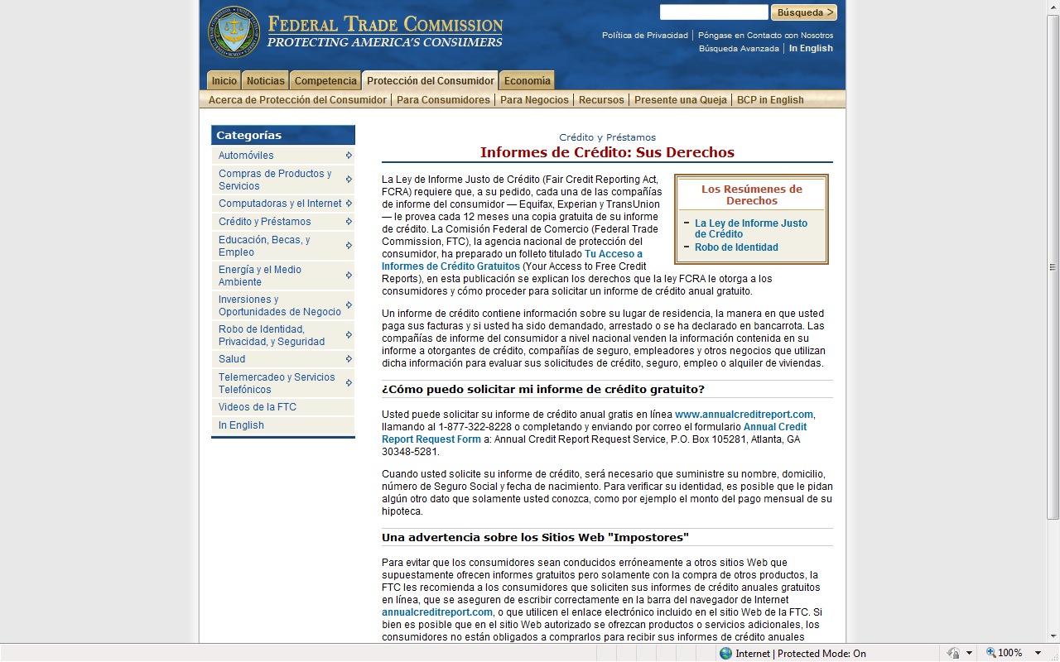

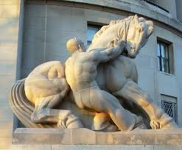
http://www.ftc.gov/bcp/menus/consumer/credit/rights_es.shtm

Slide 42
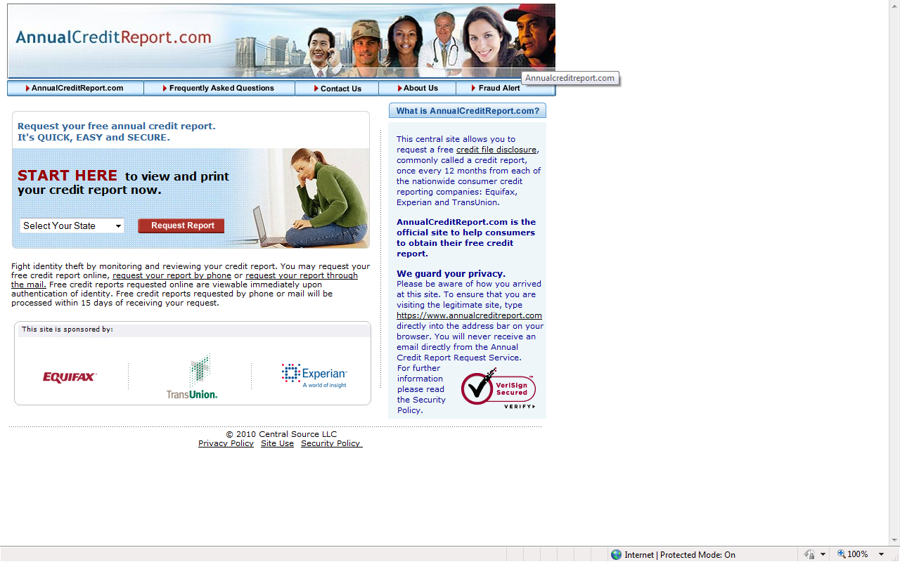
La Ley de Informe Justo de Crédito (Fair Credit Reporting Act, FCRA) requiere que, a su pedido, cada una de las compañías de informe del consumidor — Equifax, Experian y TransUnion — le provea cada 12 meses una copia gratuita de su informe de crédito.

Slide 43
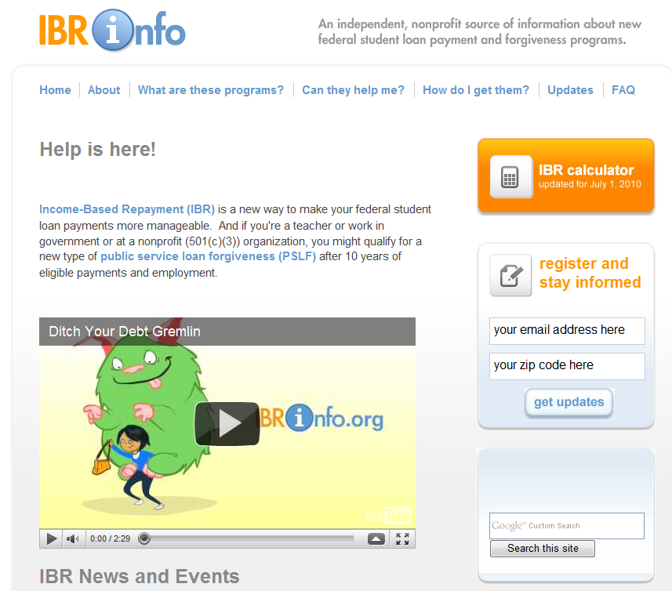
The Education Reconciliation Act of 2010
The College Cost Reduction and Access Act of 2007
http://www.ibrinfo.org/

